Slide 1
Transformers
Marco Moresi
Dialog Systems and Machine Learning Group

Slide 2
Content
Recurrent Neural Network (RNN)
What is a RNN?
Long term dependencies
Transformers
Self Attention Mechanism
Multi Head Attention
Transformer-based models
BERT
XLNet
Electra
Applications in dialogue systems
Conclusion

Slide 3
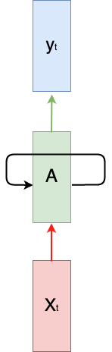
Recurrent Neural Network
Recurrent Neural Network (RNN)
The idea behind RNNs is to make use of sequential information
Computation takes into account historical information using the recurrence
Weights are shared across time.
Different architectures
Recurrent neural network diagram

Slide 4
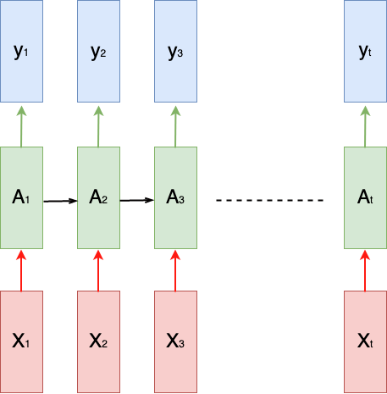
Recurrent Neural Network
Recurrent Neural Network (RNN)
The idea behind RNNs is to make use of sequential information
Computation takes into account historical information using the recurrence
Weights are shared across time.
Different architectures
Unfolded recurrent neural network diagram

Slide 5

Recurrent Neural Network
Recurrent Neural Network (RNN)
The idea behind RNNs is to make use of sequential information
Computation takes into account historical information using the recurrence
Weights are shared across time.
Different architectures

Slide 6
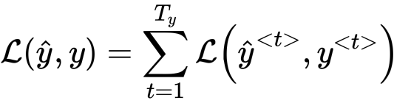

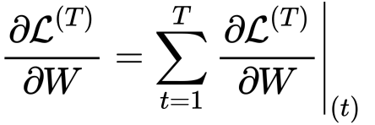
Recurrent Neural Network
Recurrent Neural Network
Loss Function
Backpropagation
Unfolded recurrent neural network diagram
Unfolded recurrent neural network diagram
Unfolded recurrent neural network diagram

Slide 7
Recurrent Neural Network
Vanishing gradient problem
The gradient value becomes small during backpropagation so does not affect the values at the beginning of the network.
Many local influences. A value is mainly influenced by inputs that are somewhere close.
Lack of long term dependencies
Unenrolled recurrent neural network diagram
Unfolded recurrent neural network diagram
The cat, which ate a lot of food …., was full.
The cats, which ate a lot of food …., were full.

Slide 8
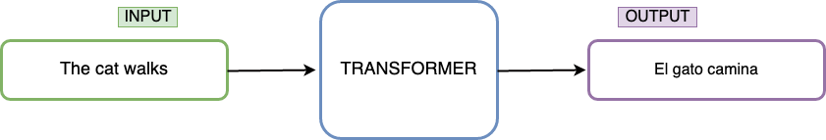
Transformers
Architecture
[Vaswani, et al. Attention is all you need, 2017]

Slide 9
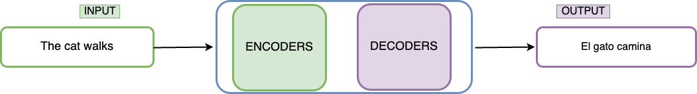
Transformers
Architecture
[Vaswani, et al. Attention is all you need, 2017]

Slide 10
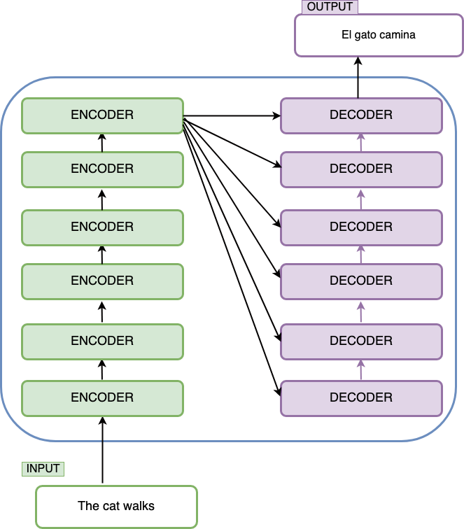
Transformers
Architecture
[Vaswani, et al. Attention is all you need, 2017]

Slide 11

Transformer
Architecture
The full model architecture of the transformer. (Image source: Fig 1 & 2 in “Attention is all you need” Vaswani, et al., 2017)

Slide 12
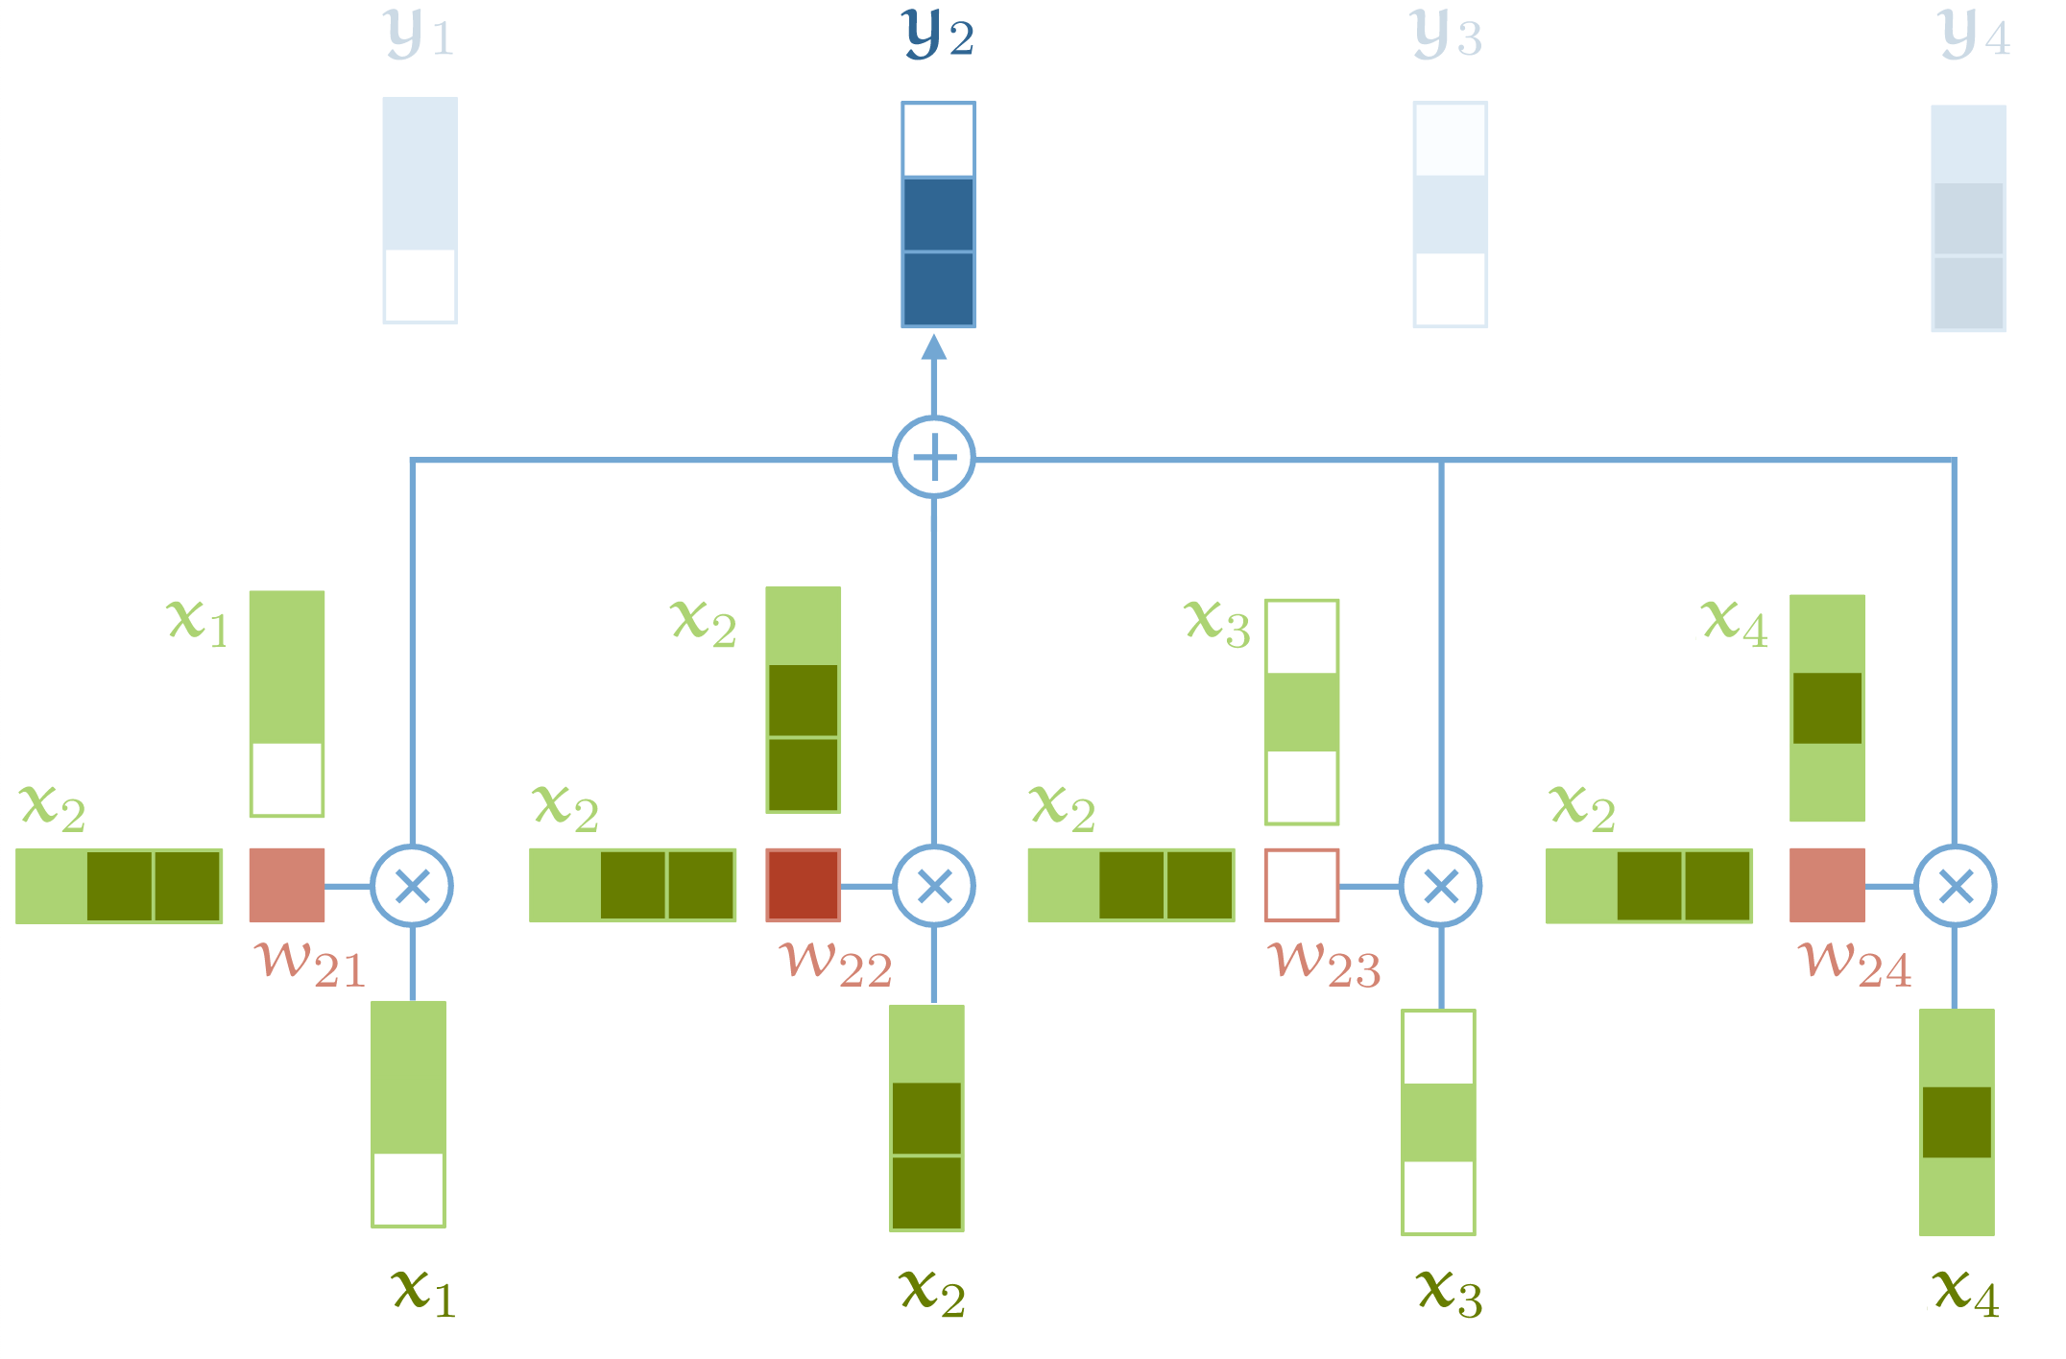
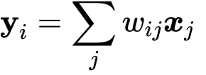
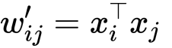
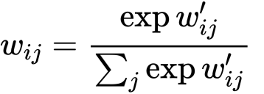
Transformer
Self-Attention
Sequence to Sequence Operation
input vectors 𝐱₁,𝐱₂,…𝐱_{t}
output vectors 𝐲₁,𝐲₂,…,𝐲_{t}

Slide 13
Transformer
Self-Attention in action
We have the following sequence as input:
” the, cat, walks, on, the, street ”
Assign each word t in our sequence its corresponding embedding
V_{the} , V_{cat ,}V_{walks,} V_{on ,}V_{the} ,V_{street}
Feed this sequence into a self-attention layer and the output looks as follow:
Y_{the} , Y_{cat ,}Y_{walks,} Y_{on ,}Y_{the} ,Y_{street}
Where Y_{cat} is a weighted sum over all embeddings vectors in the first sequence, weighted by their dot-product with V_{cat}

Slide 14
Transformer
Queries, Keys and Values
Every input vector 𝐱_{i} is used in three different ways in the self attention operation:
Query: It is compared to every other vector to establish the weights for its own output 𝐲_{i}
Key: It is compared to every other vector to establish the weights for the output of the j-th vector 𝐲_{j}
Value: It is used as part of the weighted sum to compute each output vector once the weights have been established.

Slide 15
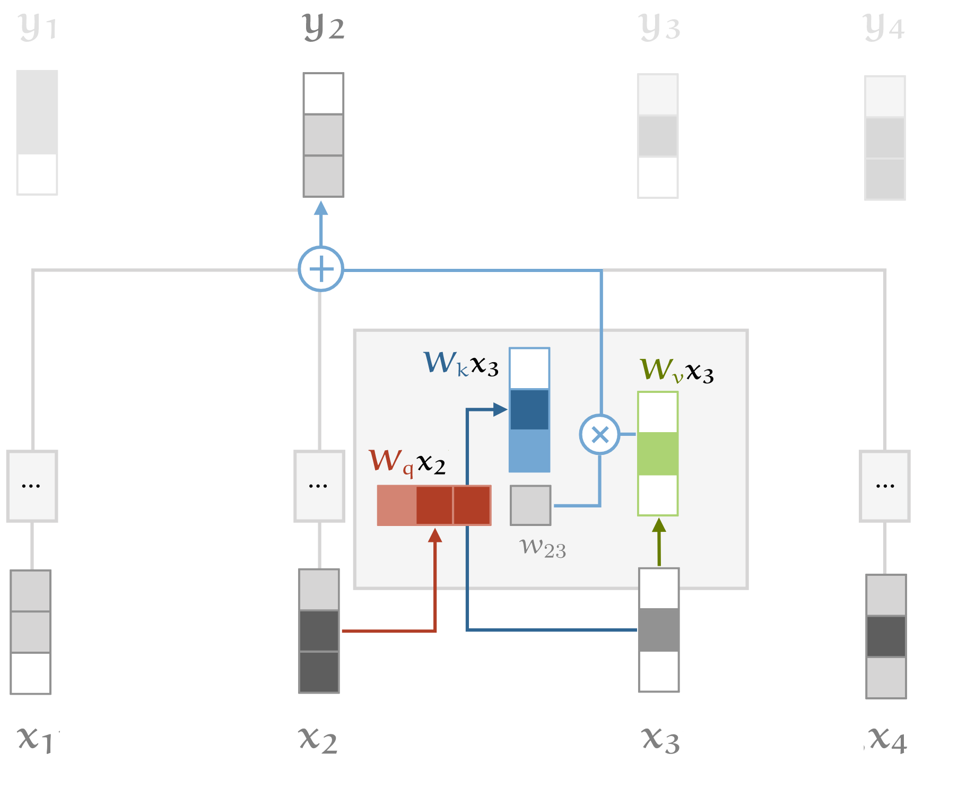
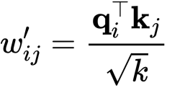
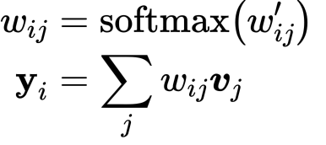
Transformer
Queries, Keys and Values
In order to calculate the query, keys and values vectors we incorporate W_{q} W_{k} W_{v} matrices
Self-attention with query, key and values transformations

Slide 16
Transformer
Multi-Head Attention
Given the sequence:
“Juan gave roses to Susan”
Words like ”gave” has different relations to different parts of the sentence.
In a single Self-Attention operation all the information just gets summed together.
If “Susan gave roses to Juan” instead, the output vector Y_{gave} would be the same even though the meaning has changed.
We can give the self attention greater power of discrimination, by combining several self attention mechanisms

Slide 17
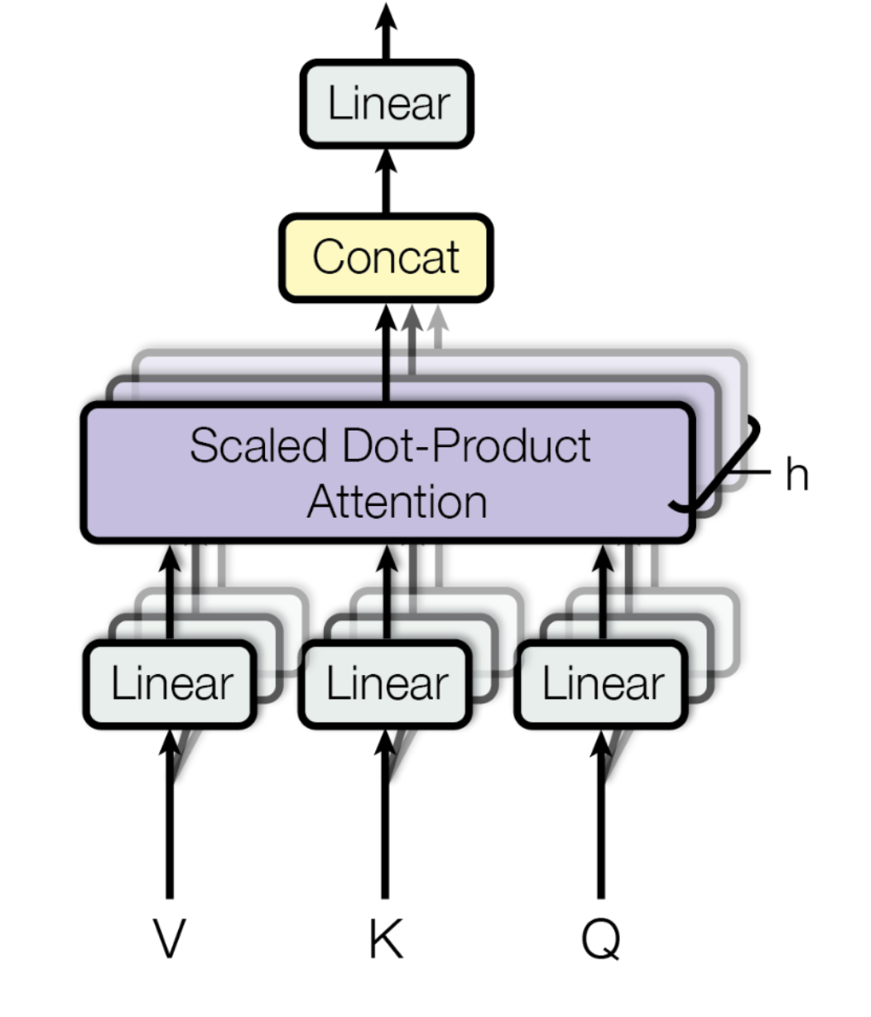
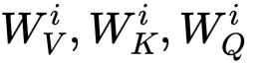
Transformer
Multi-Head Attention
Multi-head attention allows the model to jointly attend to information from different representation subspaces at different position
Each head i has its own matrices W^{i}_{v}, W^{i}_{k}, W_{q}^{i} to do the projections into different subspaces
Scaled Dot-Product Attention are calculated in parallel
All the outputs are concatenated.
Finally the concatenated output is projected with a weight matrix W^{O} that was trained jointly with the model.
Multi-Head Attention

Slide 18

Transformer
Multi-Head Attention (recap)
https://jalammar.github.io/illustrated-transformer/

Slide 19
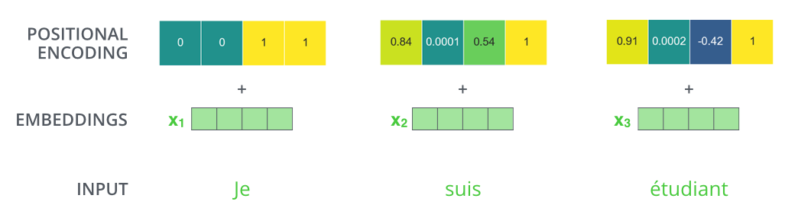
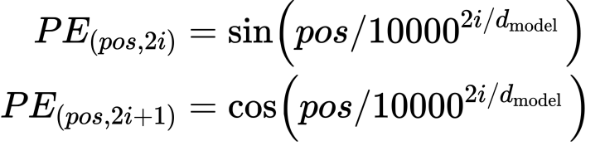
Transformer
Positional Encoding
As attention system does not take into account the order of the sequence as RNN does, is necessary to add extra information.
Positional Encoding
The
cat
walks

Slide 20
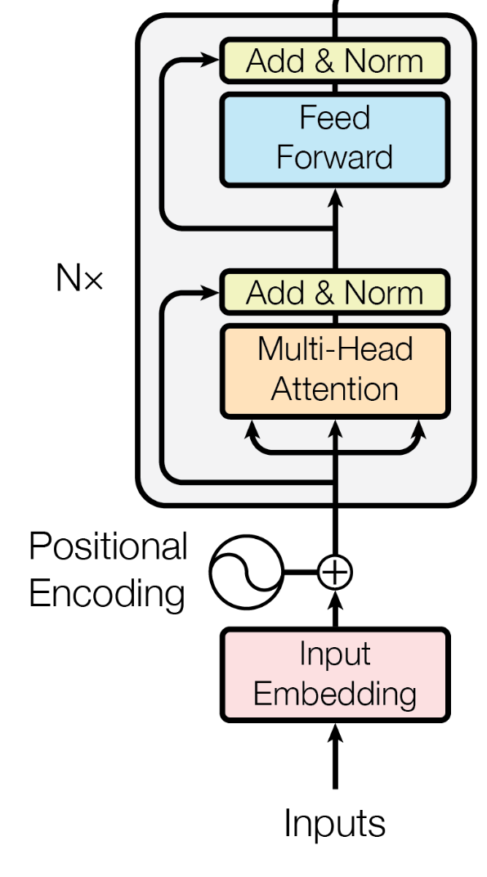
Transformer
The residuals
Each sub-layer in each encoder has a residual connection around it, and is followed by a layer-normalization step.
Normalization and residual connections are standard tricks used to help deep neural networks train faster and more accurately.
The layer normalization is applied over the embedding dimension only.
Transformer decoder block

Slide 21
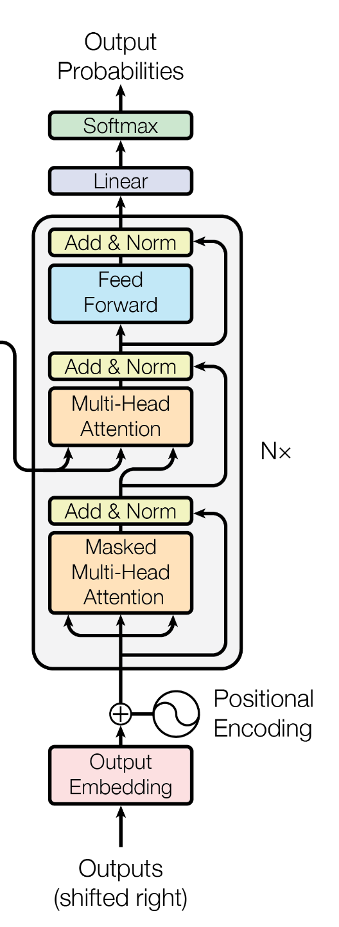
Transformer
Decoder side
The self-attention layer is only allowed to attend to earlier positions in the output sequence. This is done by masking future positions (setting them to -inf) before the softmax step in the self-attention calculation.
The Linear layer is a simple fully connected neural network that projects the vector produced by the stack of decoders, into a much, much larger vector called a logits vector.
The softmax layer then turns scores of logits vector into probabilities.
BERT decoder

Slide 22
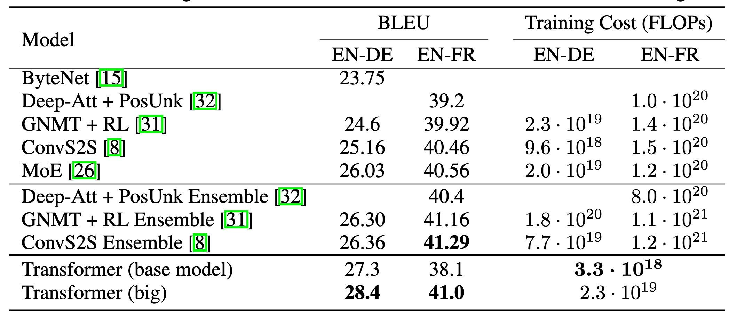
Transformer
Results
Architecture Details:
Transformer base model
Stack of 6 encoder-decoder
8 Attention heads
512 hidden dimensions
Transformer big
Stack of 6 encoder-decoder
16 Attention heads
1024 hidden dimensions
BLEU scores on the English-to-German and English-to-French newstest 2014

Slide 23
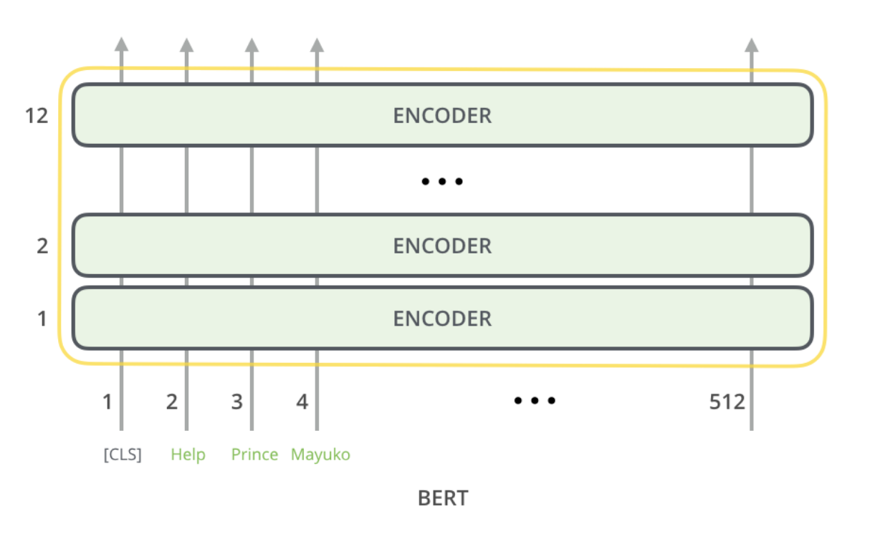
Transformer
BERT (Bidirectional Encoder Representation from Transformers)
Designed to pretrain bidirectional representation from unlabeled text
BERT-base: 12 Transformer encoder blocks, hidden dimension 768 and 12 attention heads.
Fixed input size (512 tokens)
Word embedding + Positional encoding +Sentence embedding
Special tokens ([CLS], [SEP], sentence A/B embedding)
Pre-training tasks:
Masked LM
Next Sentence Prediction
The cat walks
[Devlin, et al.. Bert: Pre-training of deep bidirectional transformers for language understanding, 2018.]

Slide 24
Transformer
BERT (Bidirectional Encoder Representation from Transformers)
Designed to pretrain bidirectional representation from unlabeled text
BERT-base: 12 Transformer encoder blocks, hidden dimension 768 and 12 attention heads.
Fixed input size (512 tokens)
Word embedding + Positional encoding +Sentence embedding
Special tokens ([CLS], [SEP], sentence A/B embedding)
Pre-training tasks:
Masked LM
Next Sentence Prediction
Masked Language Model:
Mask some percentage of the input tokens at random, and then predict those masked tokens.
Last hidden vector corresponding to the masked tokens are fed into an output softmax layer over the vocabulary
The cat walks
[Devlin, et al.. Bert: Pre-training of deep bidirectional transformers for language understanding, 2018.]

Slide 25
Transformer
BERT (Bidirectional Encoder Representation from Transformers)
Designed to pretrain bidirectional representation from unlabeled text
BERT-base: 12 Transformer encoder blocks, hidden dimension 768 and 12 attention heads.
Fixed input size (512 tokens)
Word embedding + Positional encoding +Sentence embedding
Special tokens ([CLS], [SEP], sentence A/B embedding)
Pre-training tasks:
Masked LM
Next Sentence Prediction
Next Sentence Prediction:
Given a pair of two sentences (A, B)
Learns to predict if the second sentence in the pair is the subsequent sentence in the original document
The cat walks
[Devlin, et al.. Bert: Pre-training of deep bidirectional transformers for language understanding, 2018.]

Slide 26
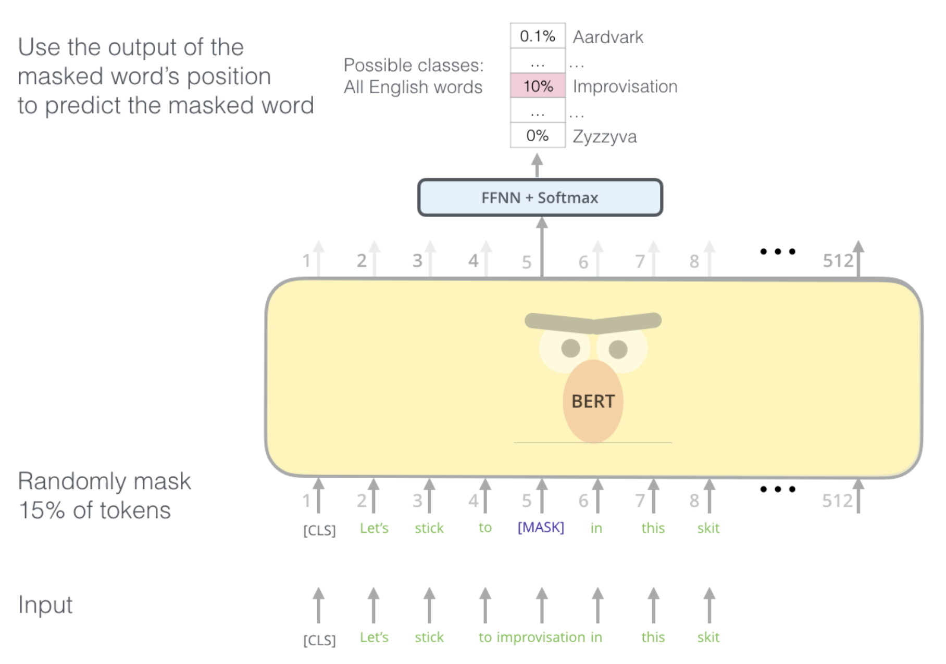
Transformer
Masked Language Model

Slide 27
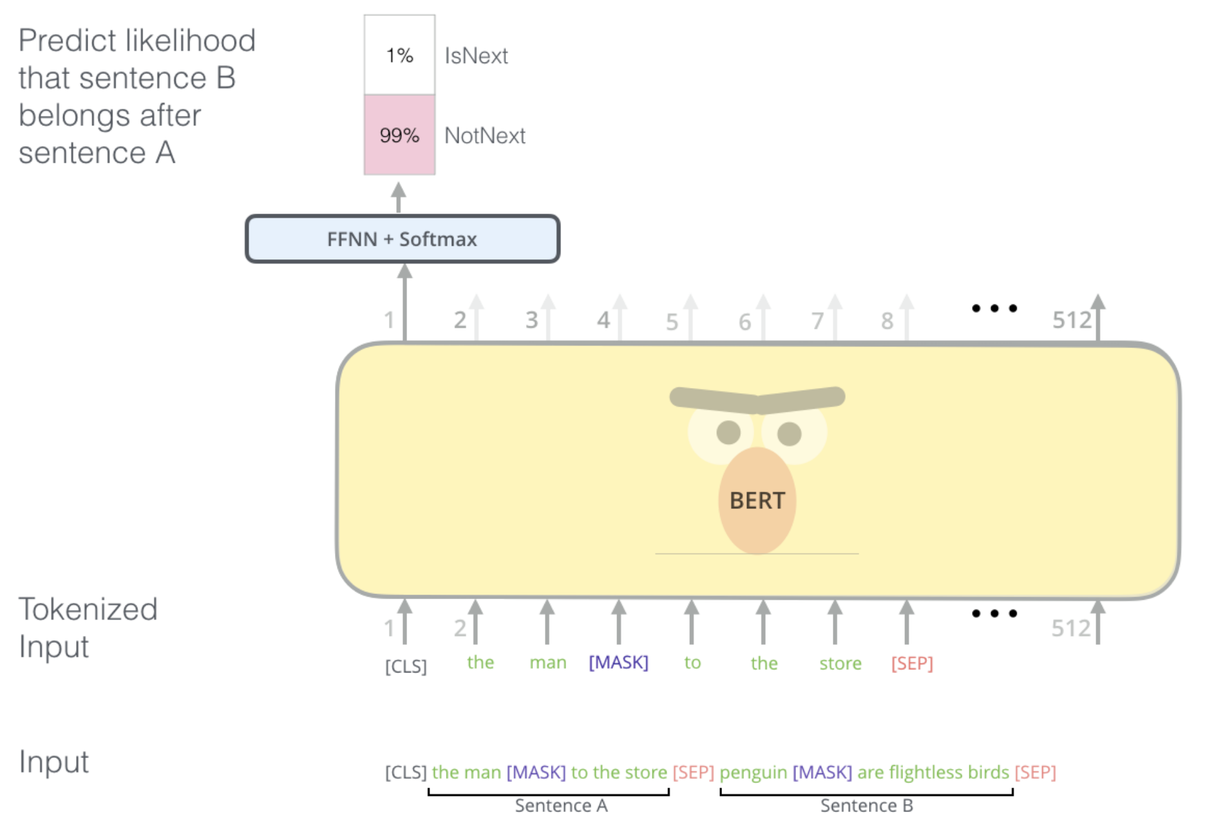
Transformer
Next Sentence Prediction

Slide 28
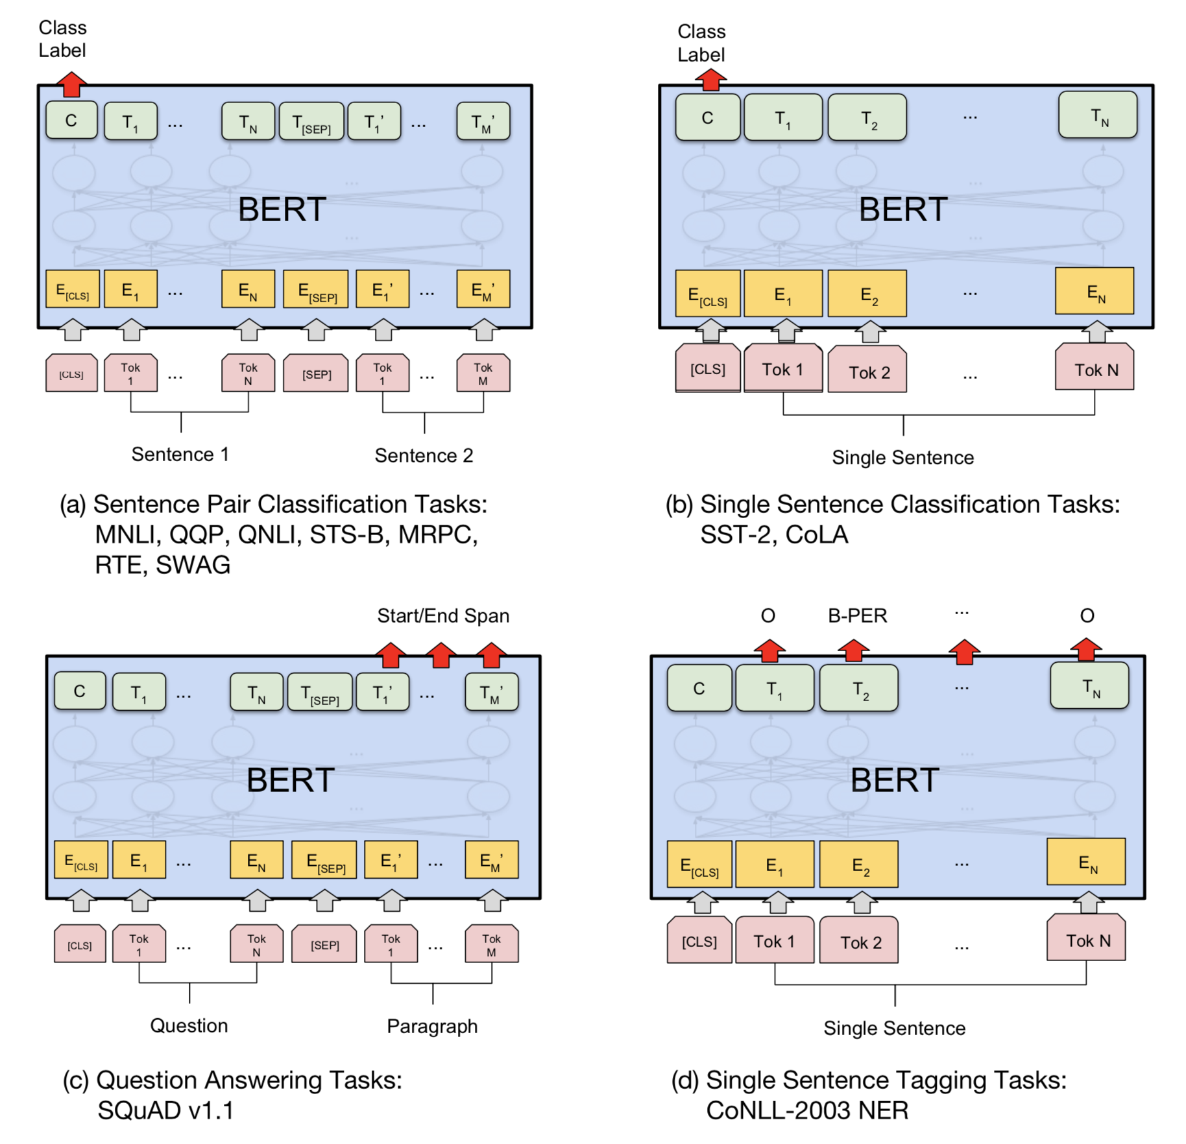
Transformer
Fine Tuning

Slide 29
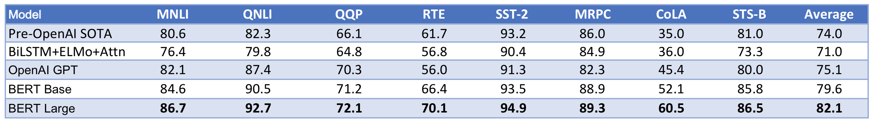
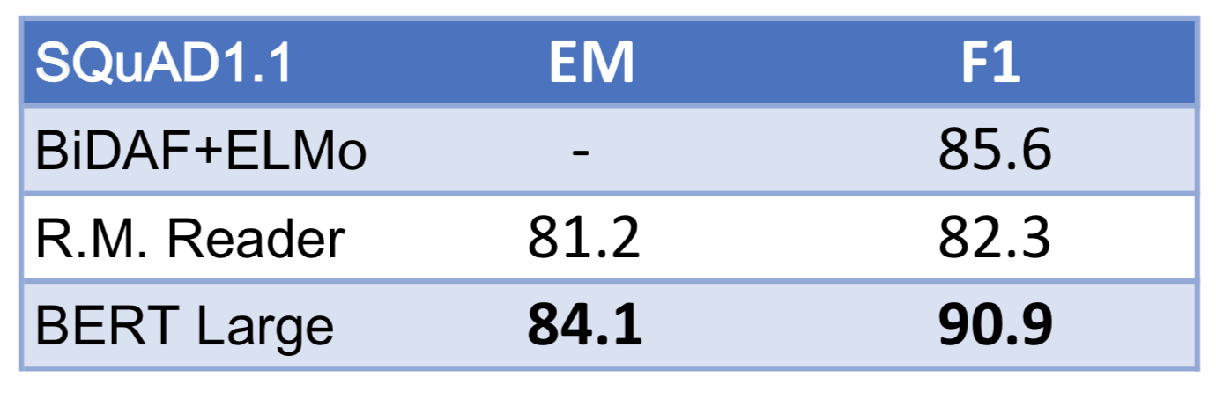
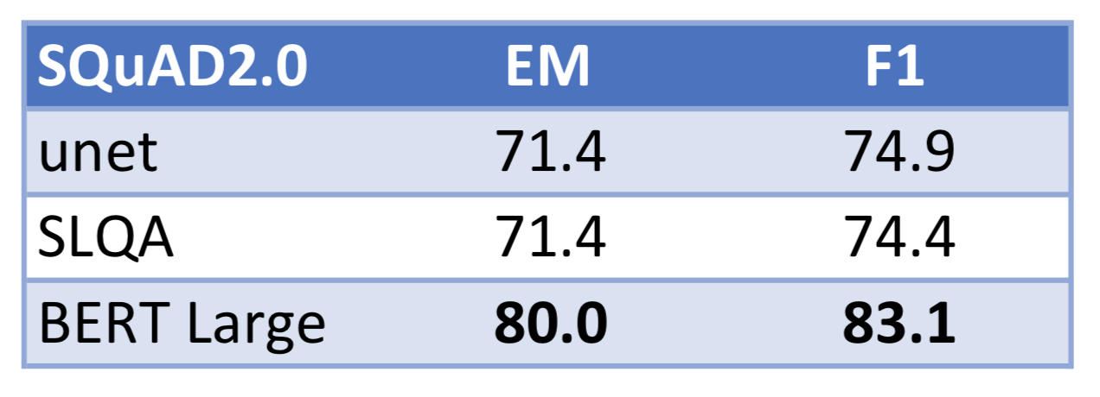
Transformer
Benchmarks
GLUE Test results
SQuAD 1.1 results
SQuAD 2.0 results

Slide 30
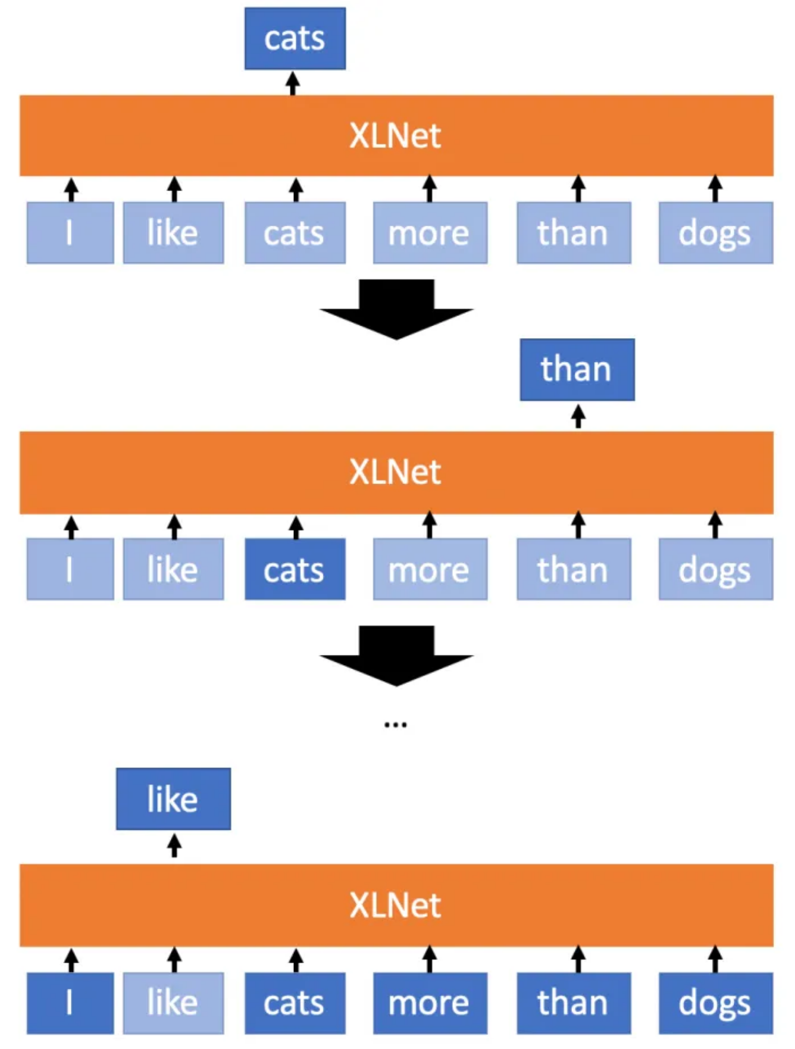
Transformer
XLNet (Generalized Autoregressive Pretraining for Language Understanding )
Permutation Language Modeling
Does not rely on data corruption
Integrates the segment recurrence mechanism and relative encoding.
Mitigate the problem of Masked Language Model
[Yang, et al. Xlnet: Generalized autoregressive pretraining for languageunderstanding, 2019]
XLNet - Permutation Language Modeling

Slide 31
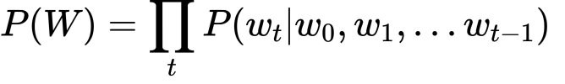
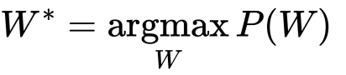
Transformer
Language Model:
XLNet (Generalized Autoregressive Pretraining for Language Understanding )
Permutation Language Modeling
Does not rely on data corruption
Integrates the segment recurrence mechanism and relative encoding.
Mitigate the problem of Masked Language Model
[Yang, et al. Xlnet: Generalized autoregressive pretraining for languageunderstanding, 2019]
XLNet - Permutation Language Modeling

Slide 32
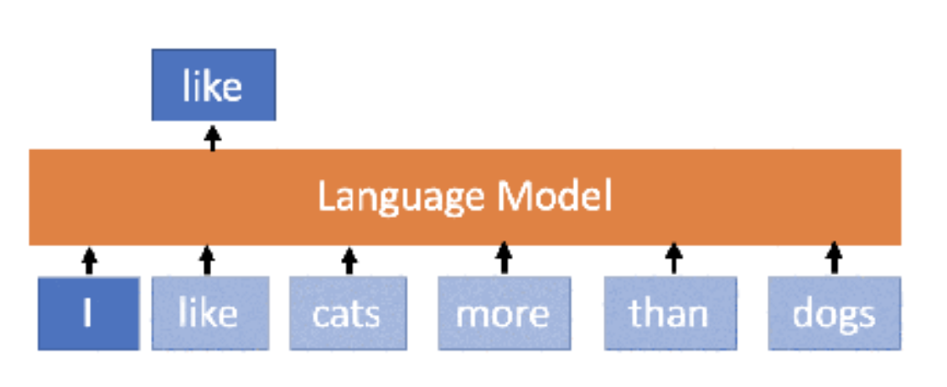
Transformer
XLNet (Generalized Autoregressive Pretraining for Language Understanding )
Permutation Language Modeling
Does not rely on data corruption
Integrates the segment recurrence mechanism and relative encoding.
Mitigate the problem of Masked Language Model
[Yang, et al. Xlnet: Generalized autoregressive pretraining for languageunderstanding, 2019]
XLNet - Permutation Language Modeling

Slide 33
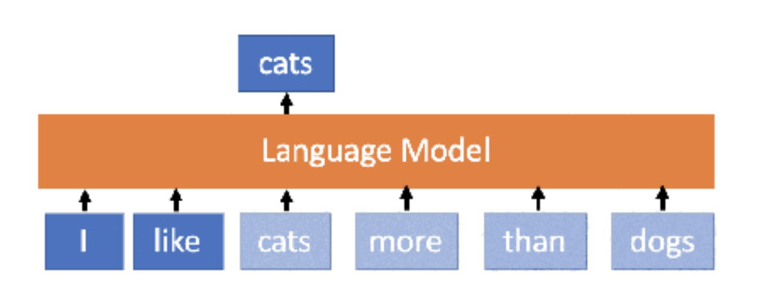
Transformer
XLNet (Generalized Autoregressive Pretraining for Language Understanding )
Permutation Language Modeling
Does not rely on data corruption
Integrates the segment recurrence mechanism and relative encoding.
Mitigate the problem of Masked Language Model
[Yang, et al. Xlnet: Generalized autoregressive pretraining for languageunderstanding, 2019]
XLNet - Permutation Language Modeling

Slide 34
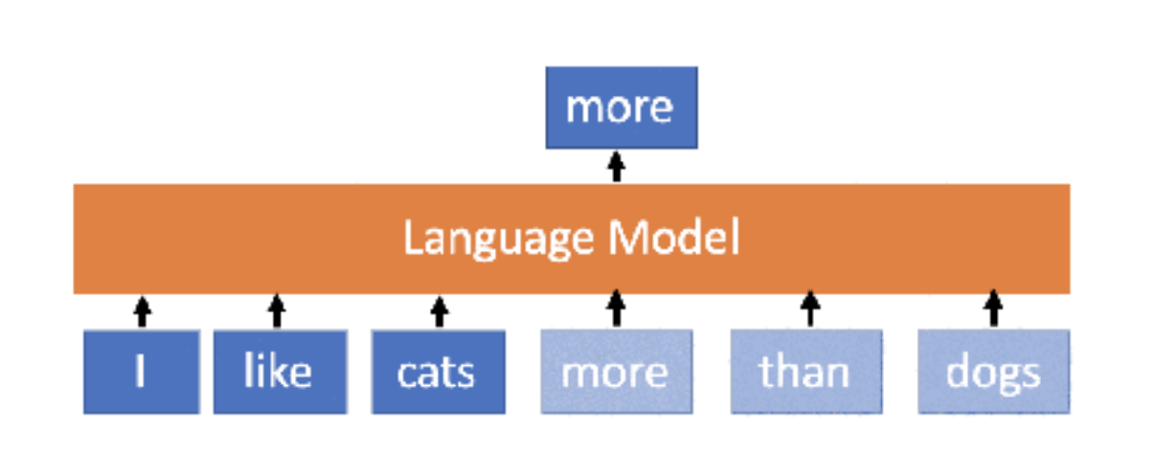
Transformer
XLNet (Generalized Autoregressive Pretraining for Language Understanding )
Permutation Language Modeling
Does not rely on data corruption
Integrates the segment recurrence mechanism and relative encoding.
Mitigate the problem of Masked Language Model
[Yang, et al. Xlnet: Generalized autoregressive pretraining for languageunderstanding, 2019]
XLNet - Permutation Language Modeling

Slide 35
Transformer
XLNet (Generalized Autoregressive Pretraining for Language Understanding )
Permutation Language Modeling
Does not rely on data corruption
Integrates the segment recurrence mechanism and relative encoding.
Mitigate the problem of Masked Language Model
[Yang, et al. Xlnet: Generalized autoregressive pretraining for languageunderstanding, 2019]
XLNet - Permutation Language Modeling

Slide 36
Transformer
"cats", "than", "I", "more", "dogs", "like"
XLNet (Generalized Autoregressive Pretraining for Language Understanding )
Permutation Language Modeling
Does not rely on data corruption
Integrates the segment recurrence mechanism and relative encoding.
Mitigate the problem of Masked Language Model
[Yang, et al. Xlnet: Generalized autoregressive pretraining for languageunderstanding, 2019]
XLNet - Permutation Language Modeling

Slide 37
Transformer
XLNet (Generalized Autoregressive Pretraining for Language Understanding )
Permutation Language Modeling
Does not rely on data corruption
Integrates the segment recurrence mechanism and relative encoding.
Mitigate the problem of Masked Language Model
[Yang, et al. Xlnet: Generalized autoregressive pretraining for languageunderstanding, 2019]
XLNet - Permutation Language Modeling

Slide 38
Transformer
XLNet (Generalized Autoregressive Pretraining for Language Understanding )
Permutation Language Modeling
Does not rely on data corruption
Integrates the segment recurrence mechanism and relative encoding.
Mitigate the problem of Masked Language Model
Example:
New York is a city
Target: Predict tokens New and York
[Yang, et al. Xlnet: Generalized autoregressive pretraining for languageunderstanding, 2019]
XLNet - Permutation Language Modeling

Slide 39
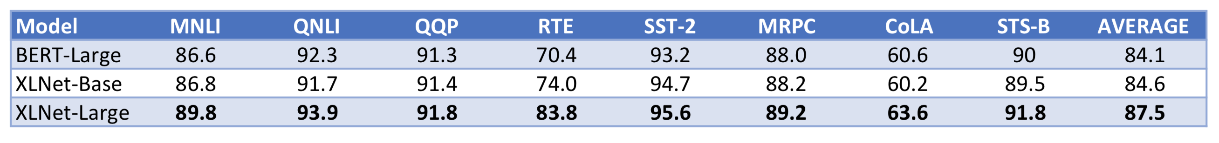
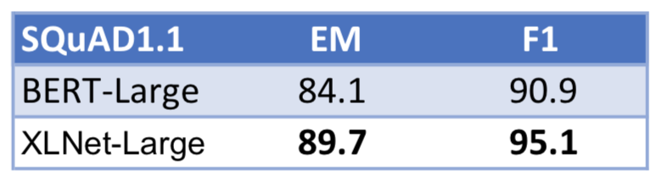
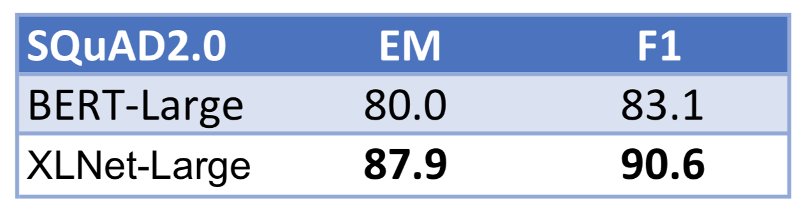
Transformer
Benchmarks
GLUE Test results
SQuAD 1.1 results
SQuAD 2.0 results

Slide 40
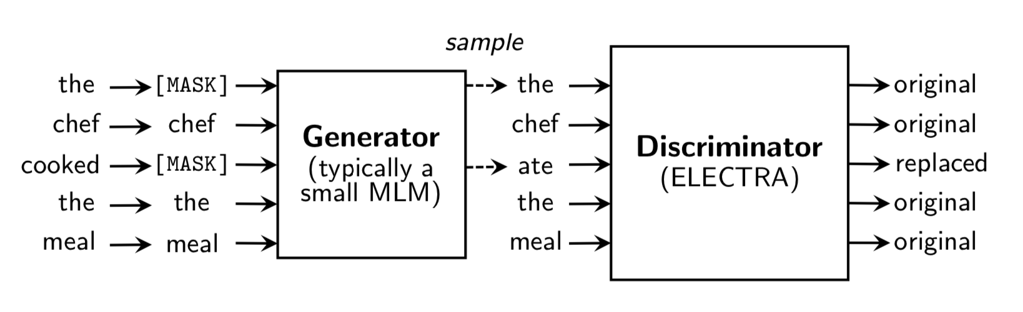
Transformer
ELECTRA (Efficiently Learning an Encoder that Classifies Token Replacements Accurately)
Mitigate the problem of Masked Language Model
Replaced token detection as pre-training task
More efficient pre training task
Bi-directional representation
Less computation consumption
An overview of replaced token detection. After pre-training, we throw out the generator
and only fine-tune the discriminator (the ELECTRA model) on downstream tasks.
[Clark, et al. Electra: Pre-training text encoders as discriminators rather than generators, 2020]

Slide 41
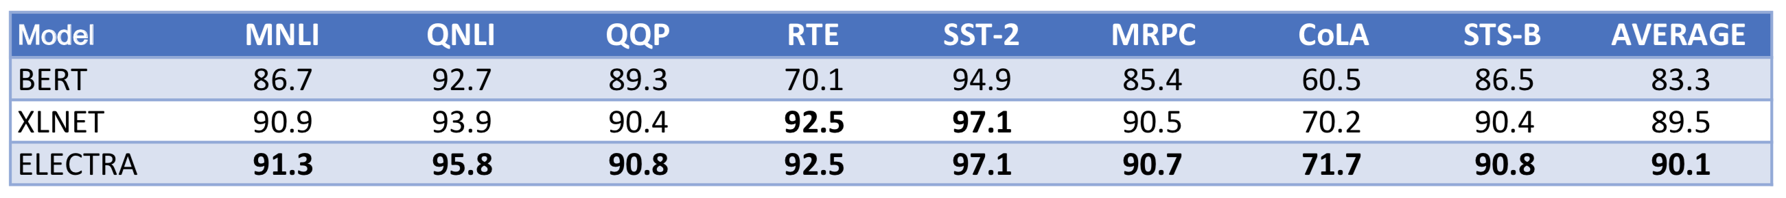
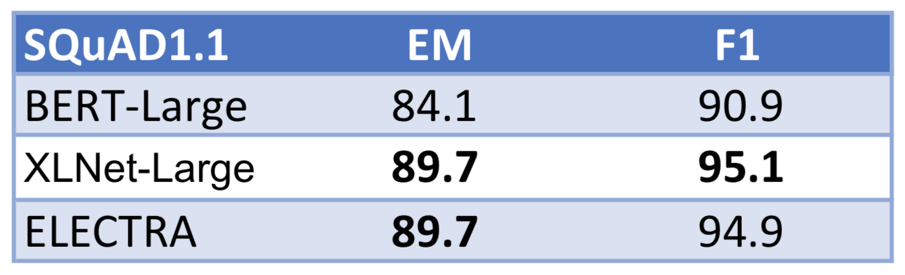
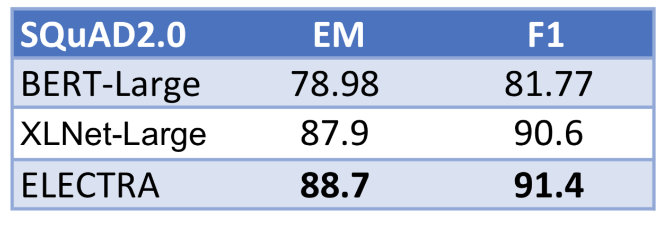
Transformer
Benchmarks
GLUE Test results
SQuAD 1.1 results
SQuAD 2.0 results

Slide 42
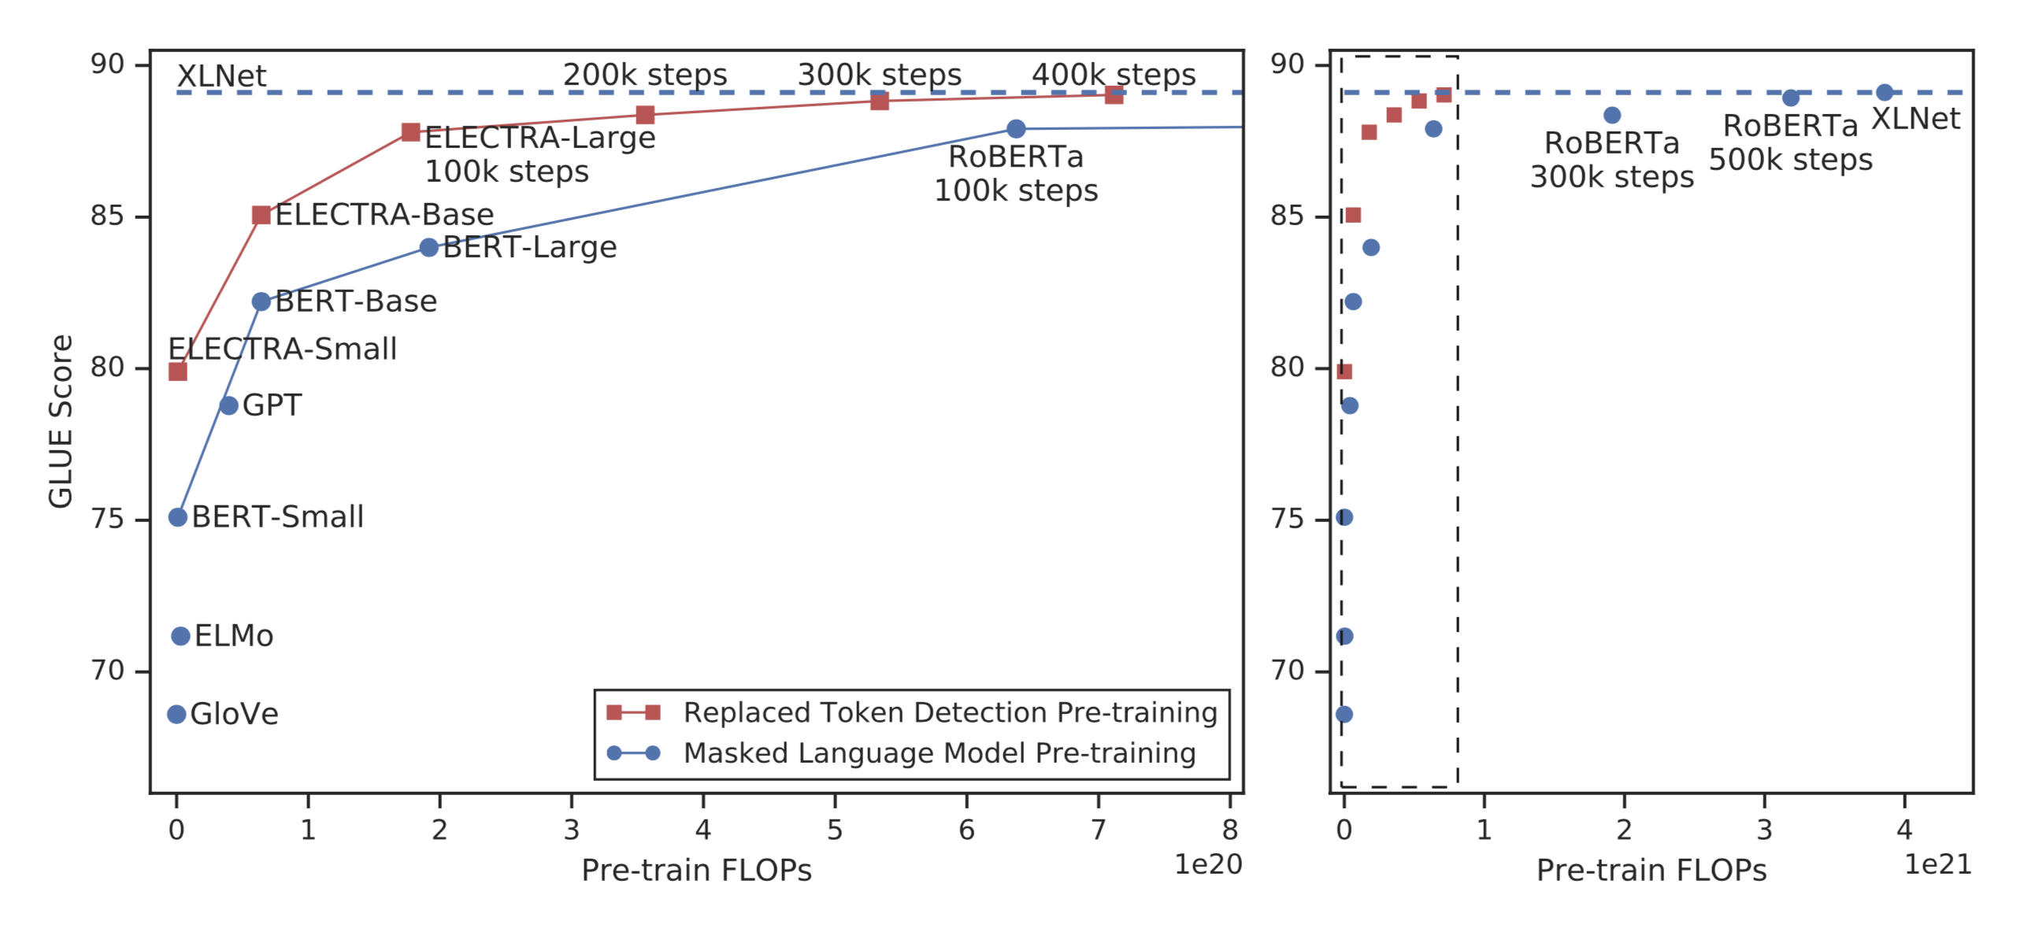
Transformer
Benchmarks
Replaced token detection pre-training consistently outperforms masked language model pre-training given the same compute budget. The left figure is a zoomed-in view of the dashed box.

Slide 43
Transformer
Applications in Dialogue Systems
Evaluation
BERTScore: Evaluating Text Generation with BERT (Zhang et al., 2019)
USR: An Unsupervised and Reference Free Evaluation Metric for Dialog Generation (Mehri et al., 2020)
Sentiments in Dialog
Hierarchical Transformer Network for Utterance-level Emotion Recognition (Li et al., 2020)
… and more.
Dialog State Tracking
TripPy: A Triple Copy Strategy for Value Independent Neural Dialog State Tracking (Heck et al., 2020)
BERT-DST: Scalable End-to-End Dialogue State Tracking with Bidirectional Encoder Representations from Transformer (Chao et al., 2019)
Natural Language Generation
Few-shot Natural Language Generation for Task-Oriented Dialog (Peng et al., 2020)
Semantically Conditioned Dialog Response Generation via Hierarchical Disentangled Self-Attention (Chen et al., 2019)

Slide 44
Conclusion
Pros
Tackle scarcity data problem
Bi-directional representation
Easy to fine-tune for a specific task
Cons
Hard to start from the scratch
Catastrophic forgetting
More expensive to train than RNN

Slide 45
Thanks!

Slide 46
References
TripPy: A Triple Copy Strategy for Value Independent Neural Dialog State Tracking (Heck et al., 2020)
BERT-DST: Scalable End-to-End Dialogue State Tracking with Bidirectional Encoder Representations from Transformer (Chao et al., 2019)
Few-shot Natural Language Generation for Task-Oriented Dialog (Peng et al., 2020)
Semantically Conditioned Dialog Response Generation via Hierarchical Disentangled Self-Attention (Chen et al., 2019)
BERTScore: Evaluating Text Generation with BERT (Zhang et al., 2019)
USR: An Unsupervised and Reference Free Evaluation Metric for Dialog Generation (Mehri et al., 2020)
Hierarchical Transformer Network for Utterance-level Emotion Recognition (Li et al., 2020)
Xlnet: Generalized autoregressive pretraining for language understanding (Yang et al., 2019)
Attention is all you need, (Vaswani et al., 2017)
Bert: Pre-training of deep bidirectional transformers for language understanding. (Devlin et al., 2018)
Glue: A multi-task benchmark and analysis platform for natural language understanding. (Wang et al, 2018)

